Slide 1

Road sign detection
Fabian Rosén & Joel Bengs
ML for IoT, EITP40 – Faculty of Engineering, Lund University
18 Dec 2023

Slide 2
Introduction
Dataset creation
Building and implementing the models
Results and evalutation

Slide 3



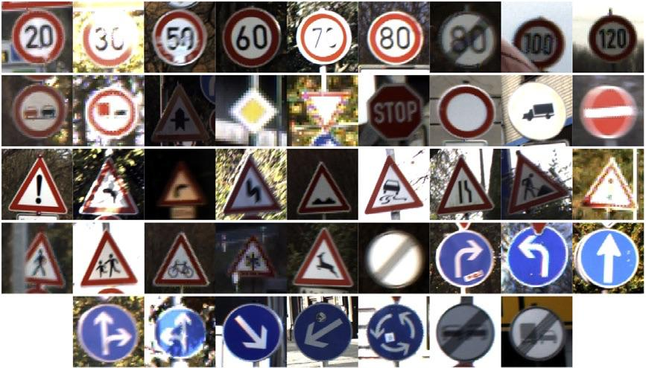

Data Collection
German Traffic Sign Recognition Benchmark (GTSRB)
Authors: Ruhr Universität Bochum
Available on Kaggle
50K+ samples in one repo

Slide 4
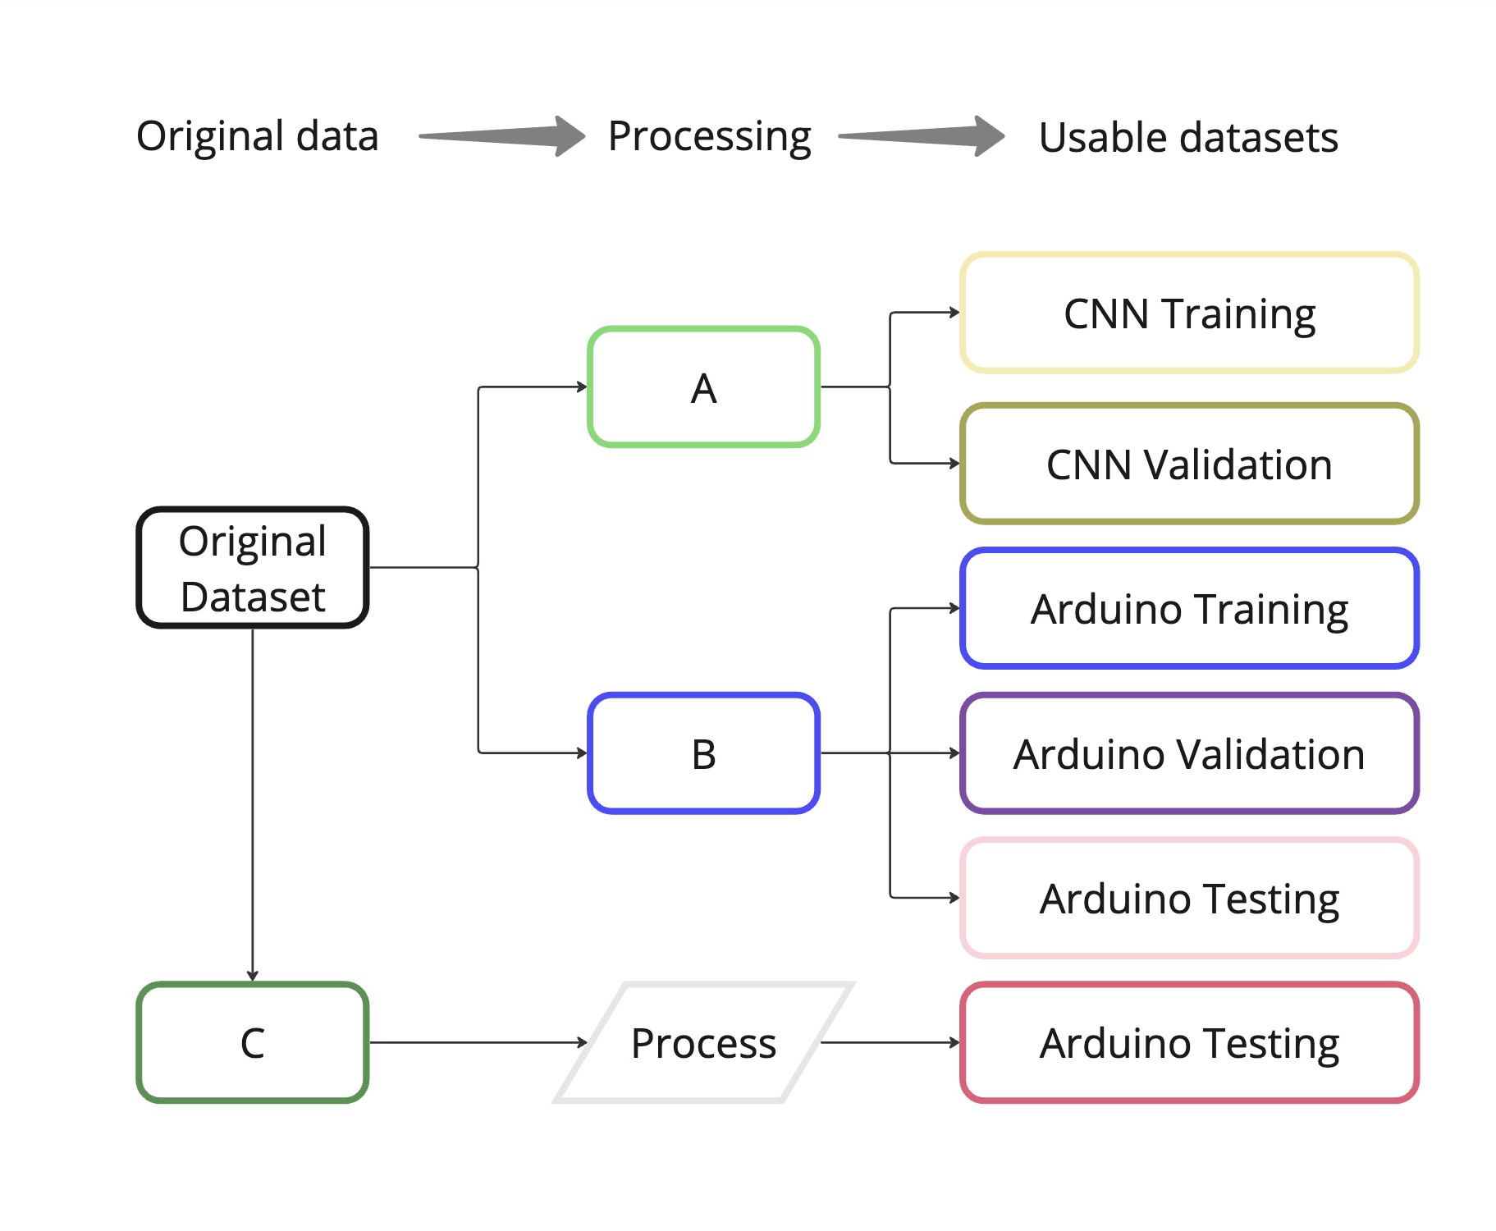
Dataset creation
An overview

Slide 5
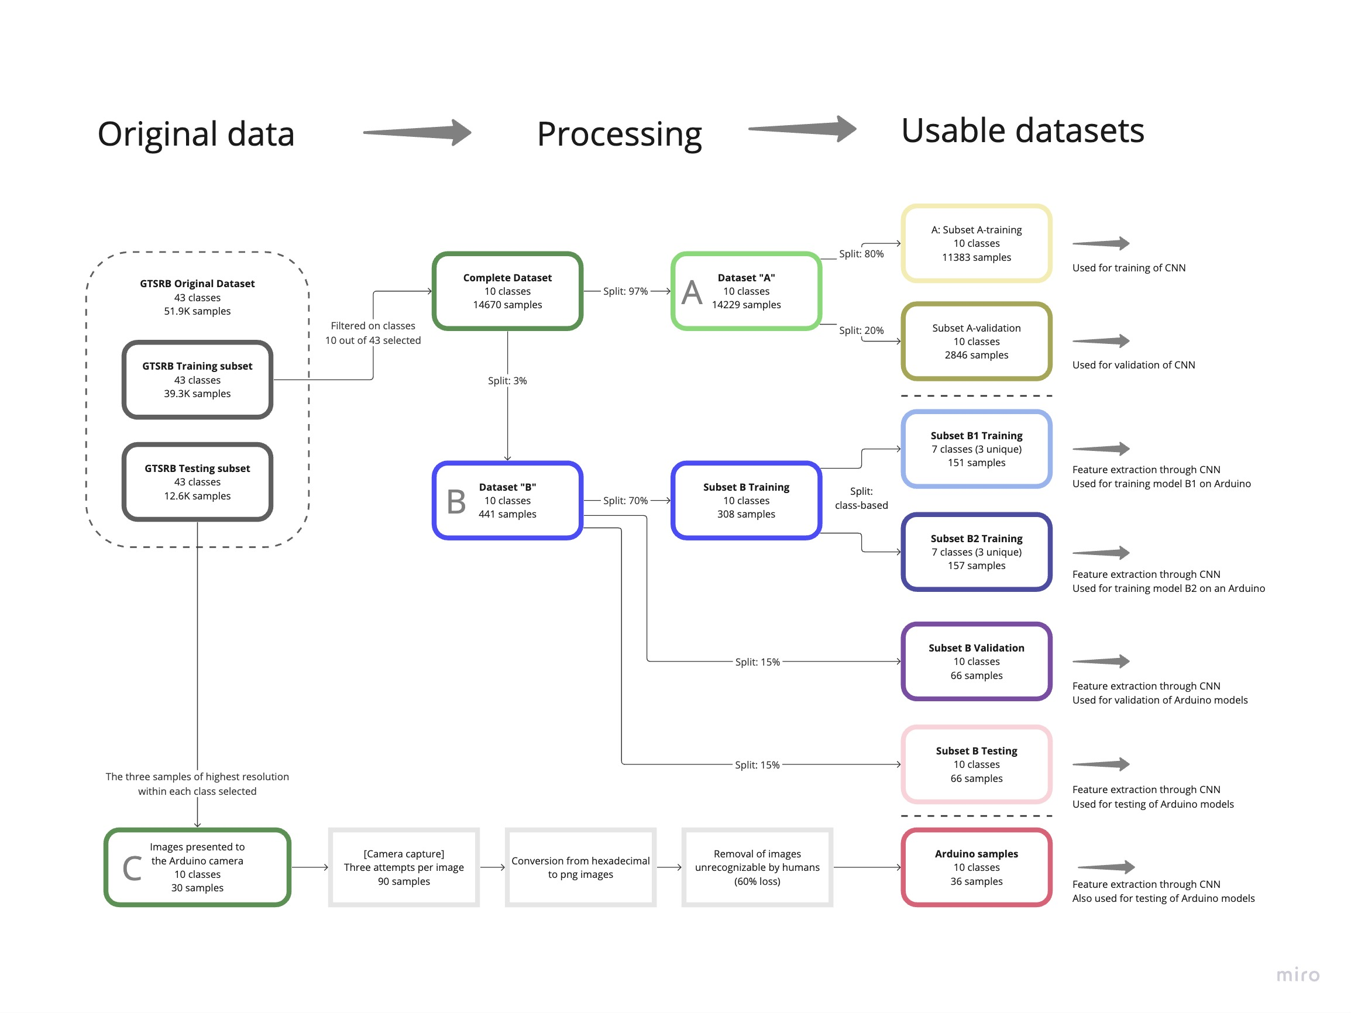
Dataset creation
The Details

Slide 6

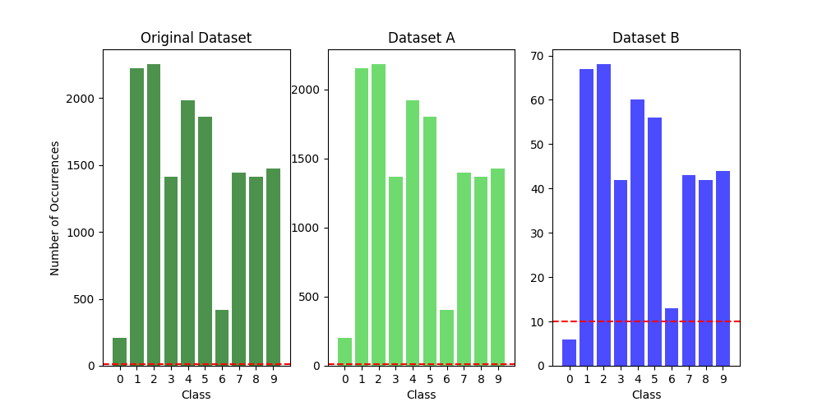
Dataset creation
Split of Original data
To A and b

Slide 7
Dataset creation
The Details

Slide 8
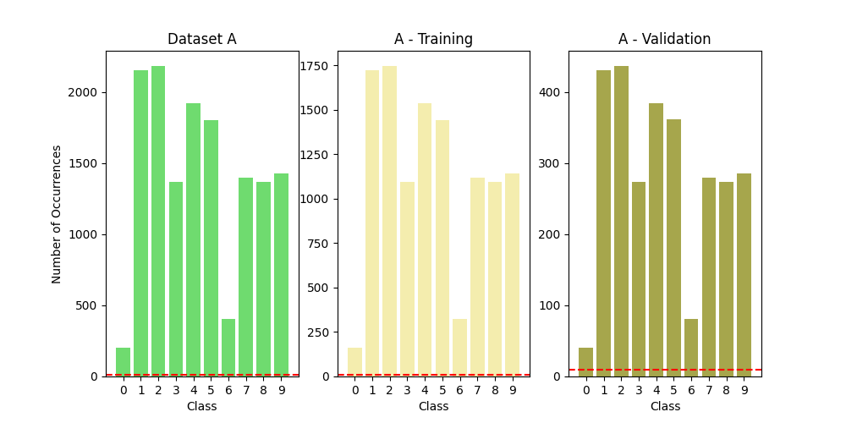
Dataset creation
Split of A

Slide 9
Dataset creation
The Details

Slide 10
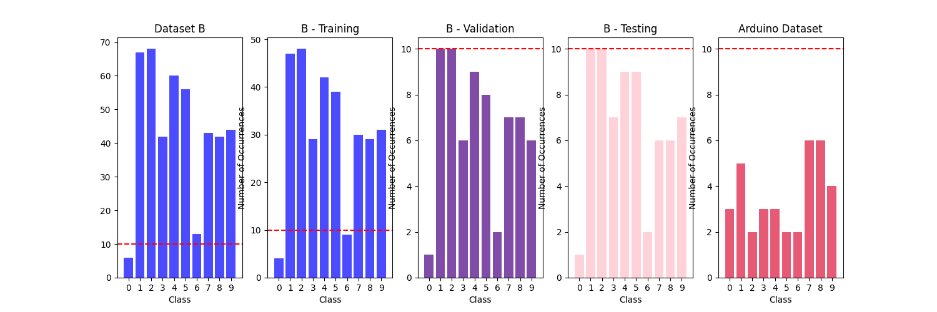
Dataset creation
Split of B

Slide 11
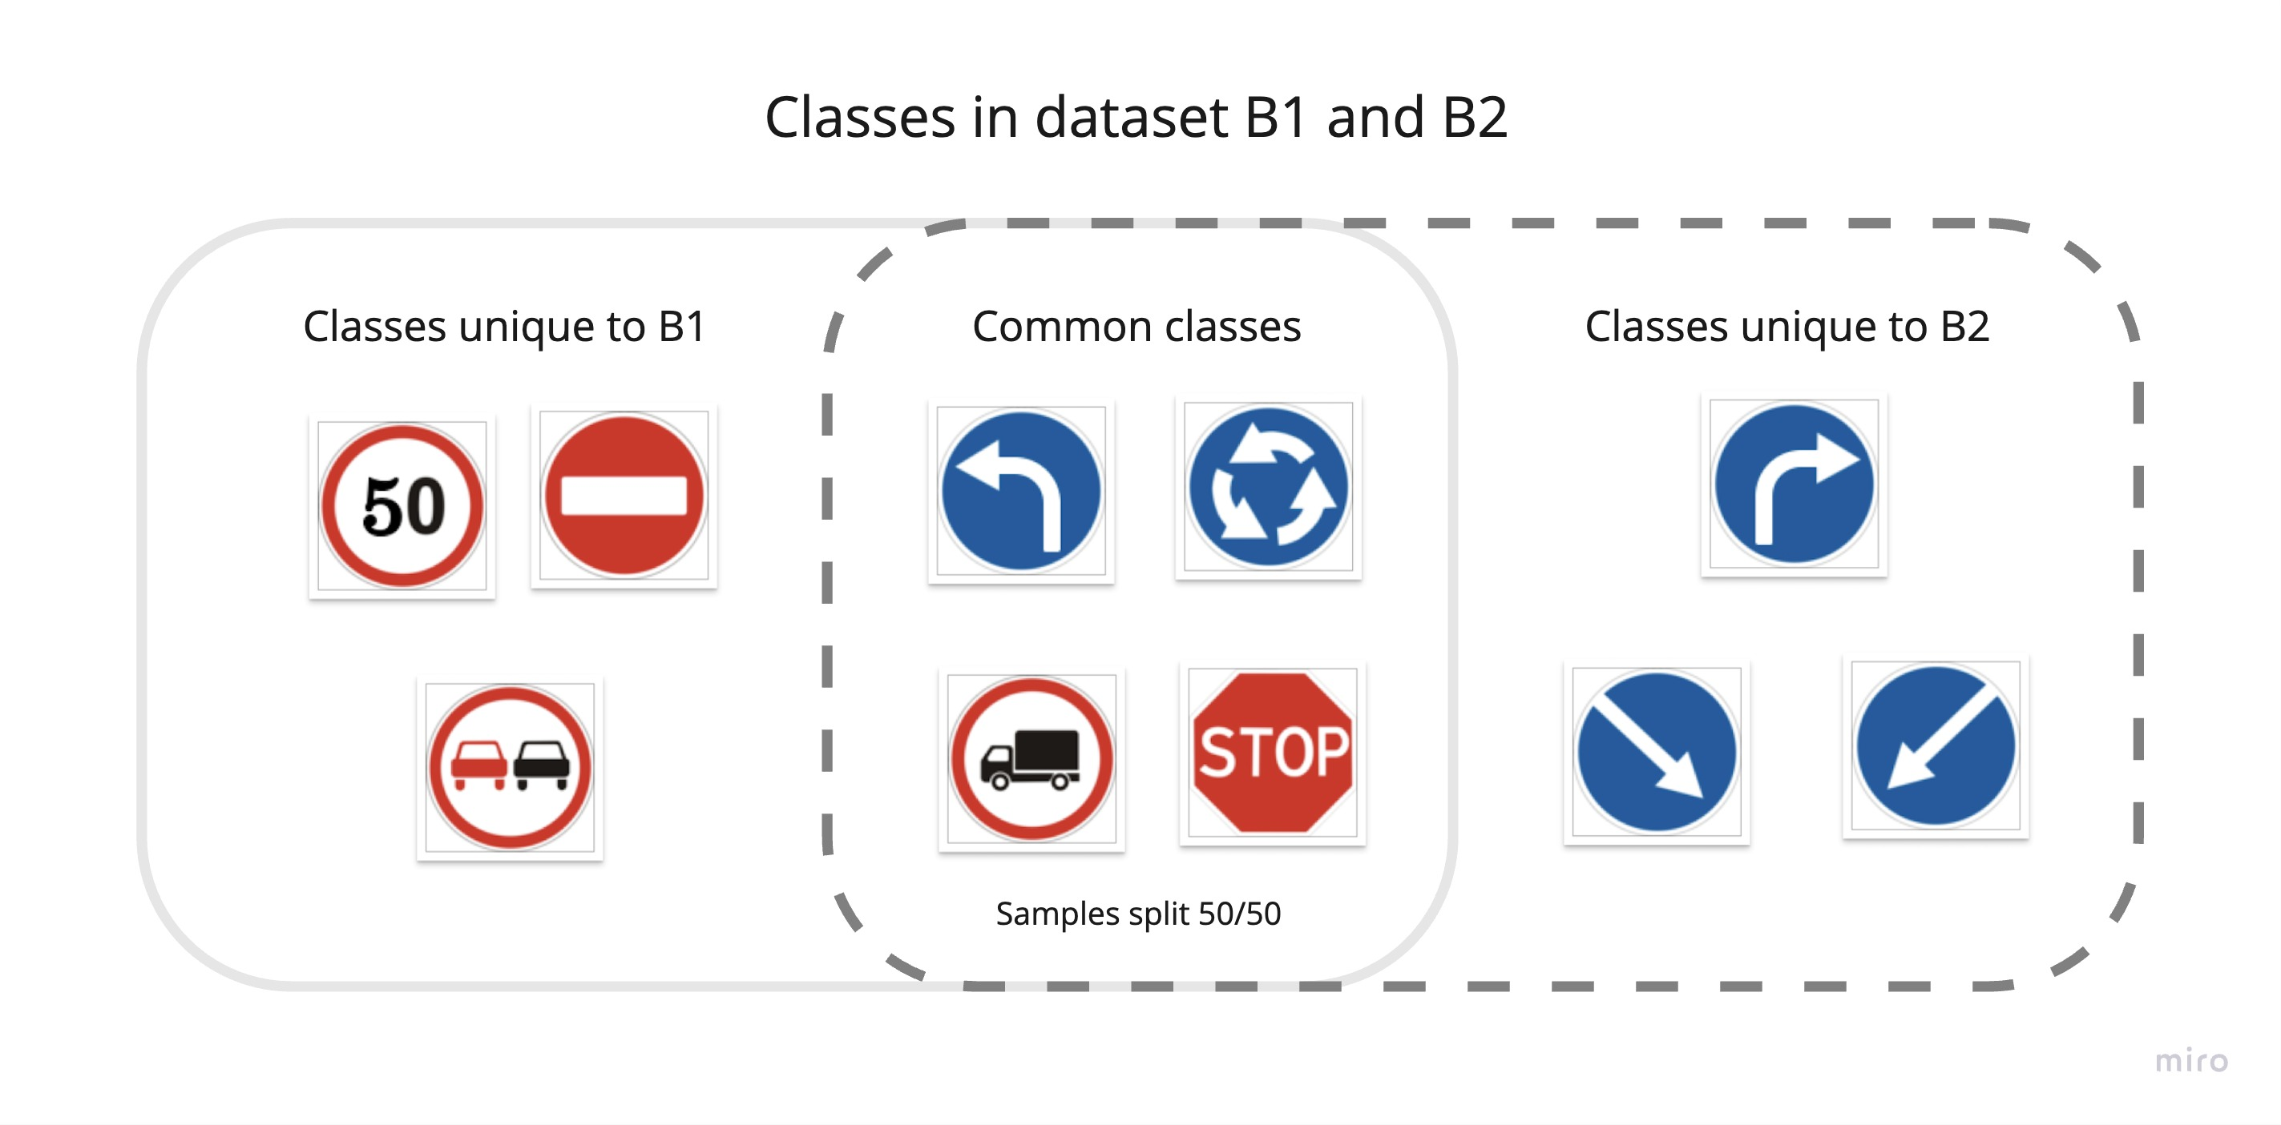
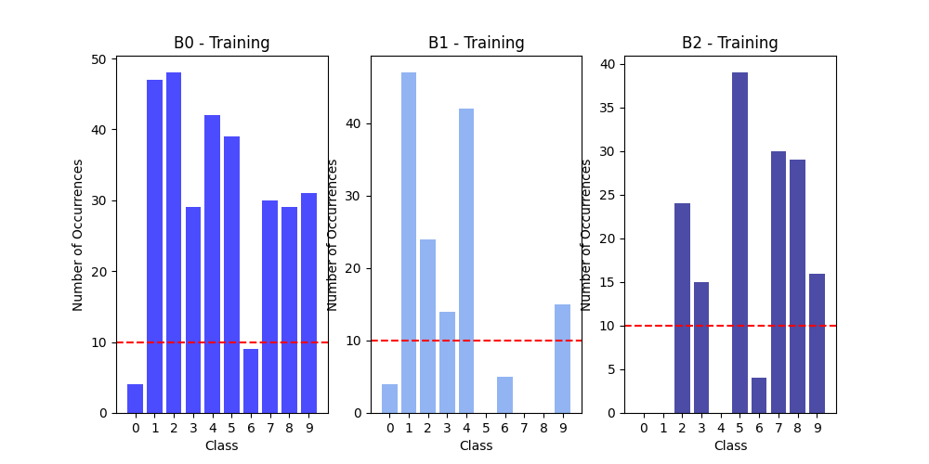
Dataset creation
Split of B0 into B1 + B2

Slide 12
Dataset creation
The Details

Slide 13
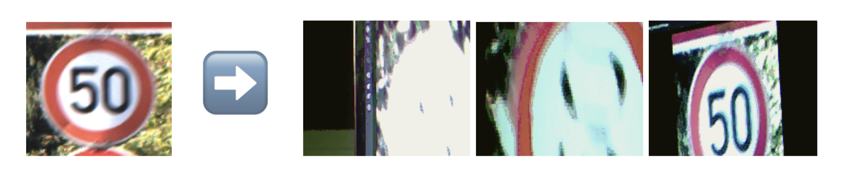
Dataset creation
Arduino Images

Slide 14
Dataset creation
The Details

Slide 15
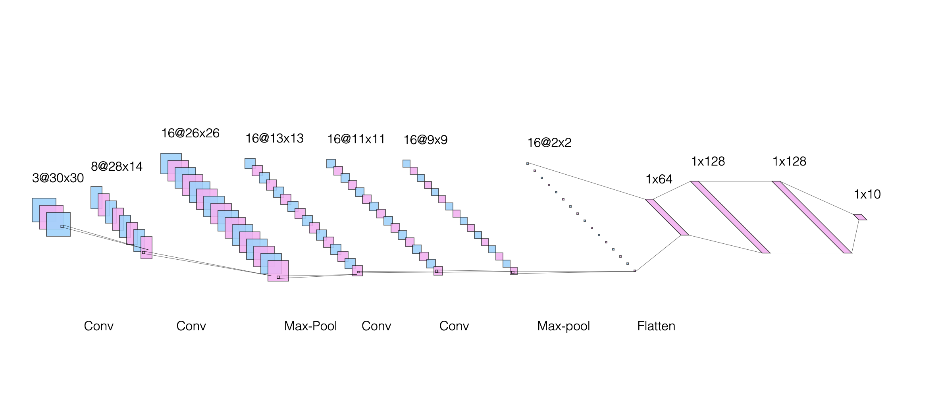
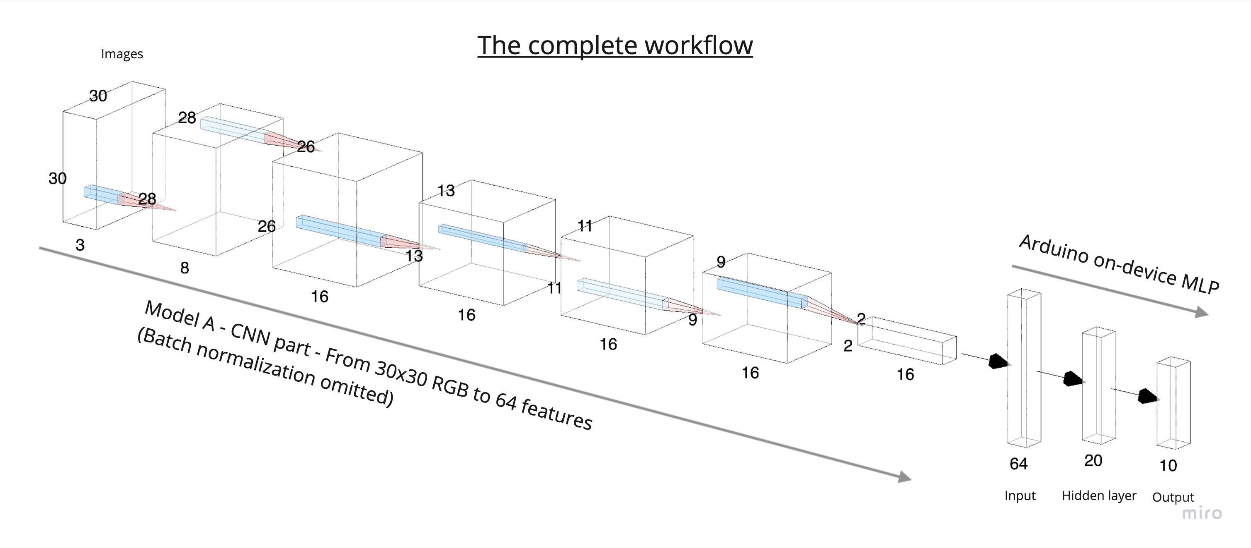
Models
The overview

Slide 16
Models
Model A – The CNN
Adapted from existing models
Dimension reduction
Trained with SGD
100 epochs
0.001 learning rate
32 batch size
Model A - The Details
Batch Normalization omitted

Slide 17
Models
The overview

Slide 18
Models
On Device
64 feature input
Trained with GD
30 epochs
0.01 learning rate
Model B - The Training
Batch Normalization omitted

Slide 19
Models
Model B1
Trained on dataset B1
Model B2
Trained on dataset B2
Model B - The Details
Batch Normalization omitted

Slide 20
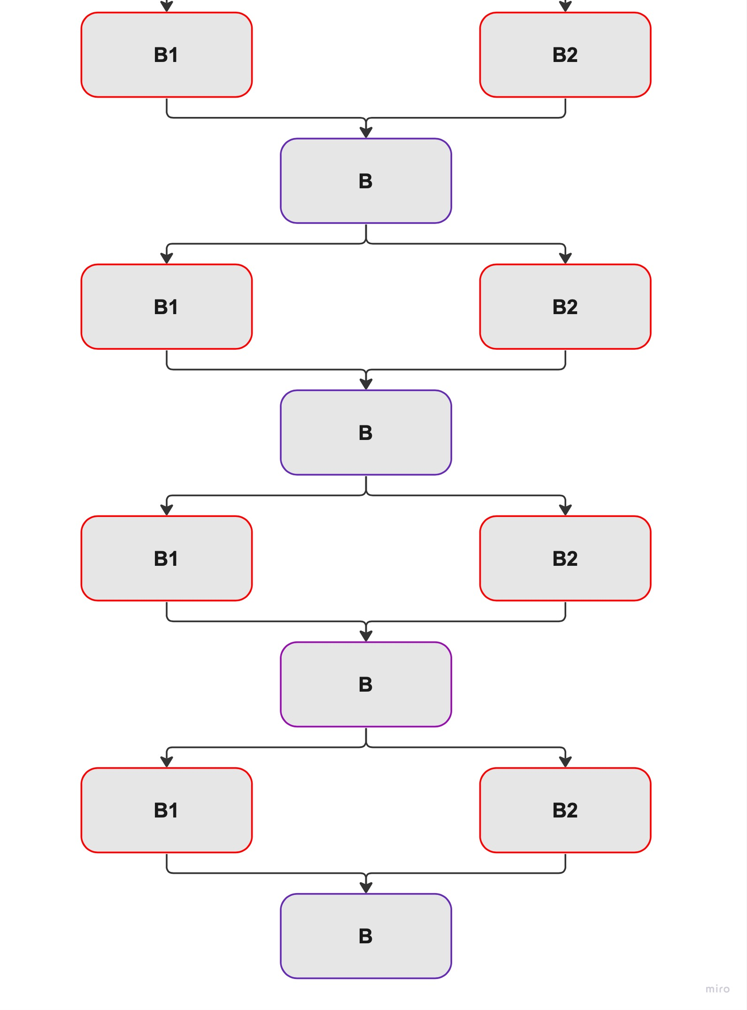
Models
Model B - The Details

Slide 21
Models
Model B1
Trained on dataset B1
+
Model B2
Trained on dataset B2
=
Model B
Distributed learning through weight sharing
Model B - The Details
Batch Normalization omitted

Slide 22
Results and evaluation
With test data from arduino pictures

Slide 23
Results and evaluation
With test data directly from original dataset

Slide 24
Results and evaluation
Test accuracy of distributed vs isolated training

Slide 25
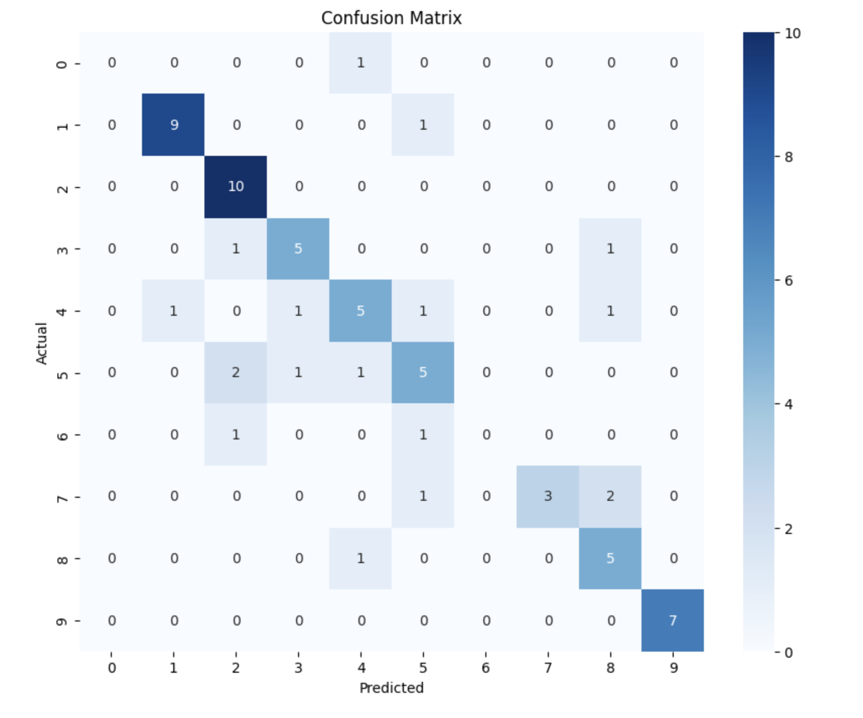
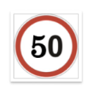









Results and evaluation
Could the distributed model predict unseen classes?

Slide 26


Summary
Data processing
On-device ML
Distributed ML
End-to-end system on Arduino only

Slide 27


Thanks for listening!
Questions?

